Slide 1
Section 12.3
Systems of Linear Equations: Determinants
Copyright © 2012 Pearson Education, Inc. Publishing as Prentice Hall.

Slide 2
Copyright © 2012 Pearson Education, Inc. Publishing as Prentice Hall.

Slide 3

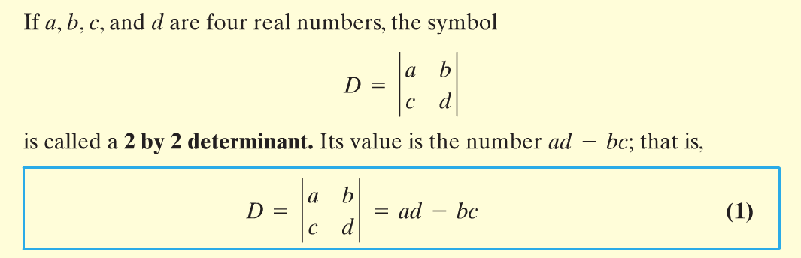
Copyright © 2012 Pearson Education, Inc. Publishing as Prentice Hall.

Slide 4
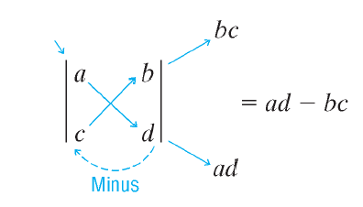
Copyright © 2012 Pearson Education, Inc. Publishing as Prentice Hall.

Slide 5

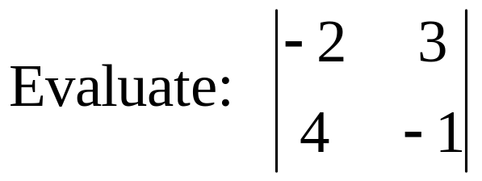
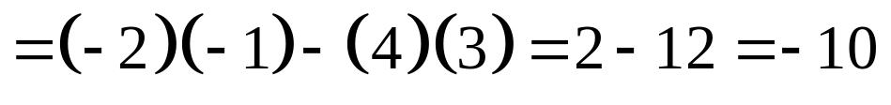
Copyright © 2012 Pearson Education, Inc. Publishing as Prentice Hall.

Slide 6
Copyright © 2012 Pearson Education, Inc. Publishing as Prentice Hall.

Slide 7
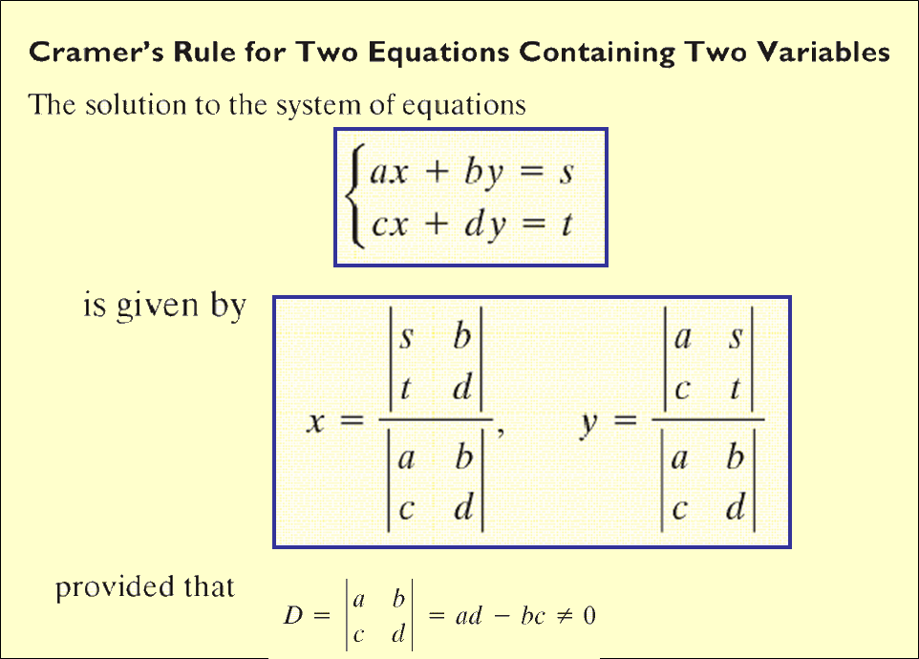
Copyright © 2012 Pearson Education, Inc. Publishing as Prentice Hall.

Slide 8
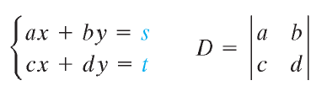
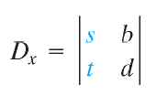



Cramer’s Rule
Copyright © 2012 Pearson Education, Inc. Publishing as Prentice Hall.

Slide 9
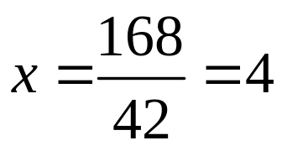
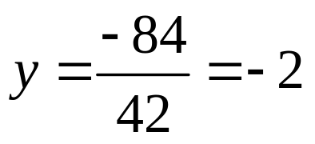
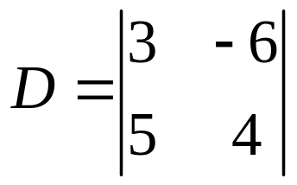
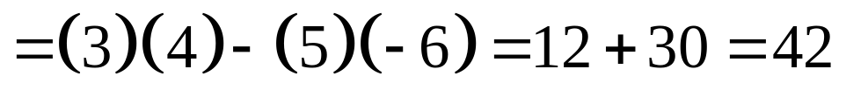
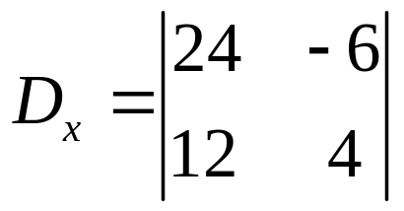
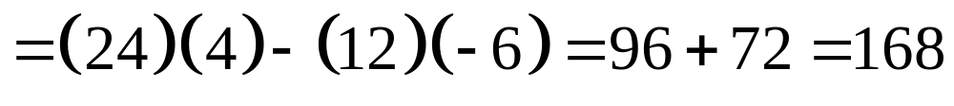
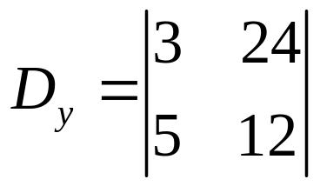
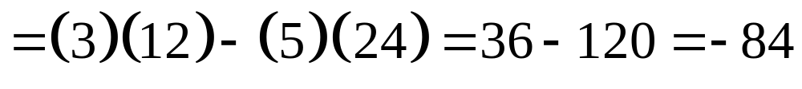
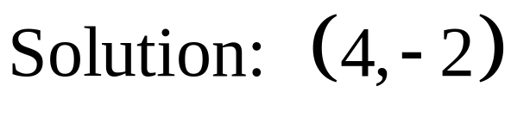
Copyright © 2012 Pearson Education, Inc. Publishing as Prentice Hall.

Slide 10

Copyright © 2012 Pearson Education, Inc. Publishing as Prentice Hall.

Slide 11
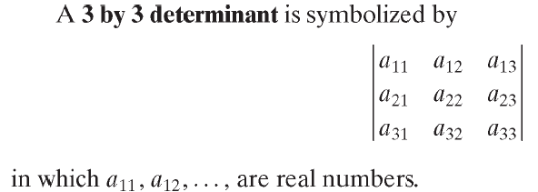
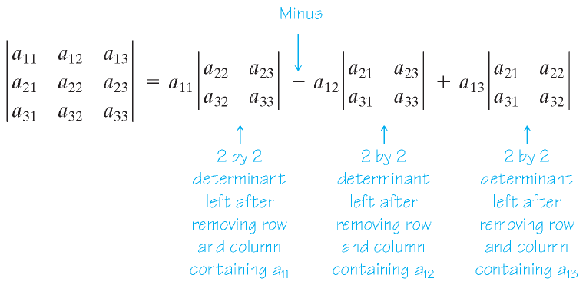
Copyright © 2012 Pearson Education, Inc. Publishing as Prentice Hall.

Slide 12
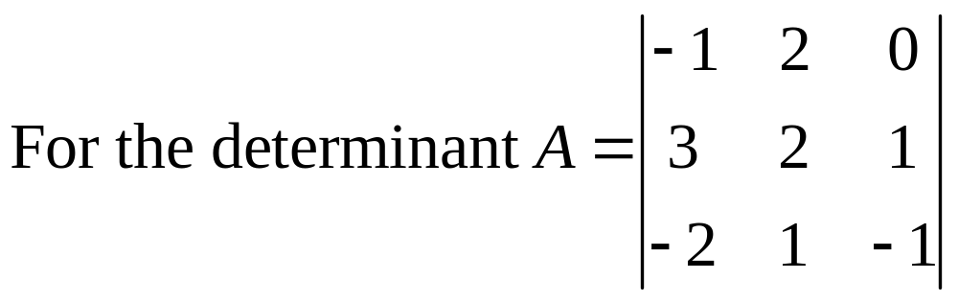
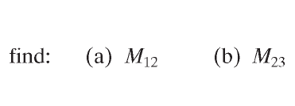
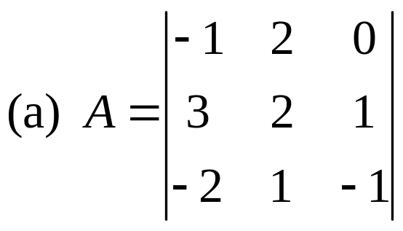
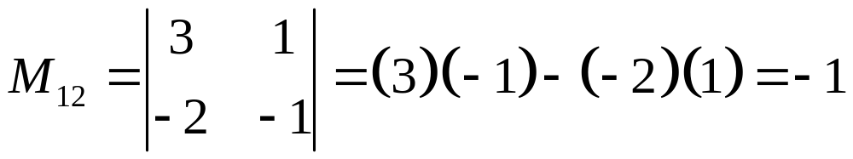
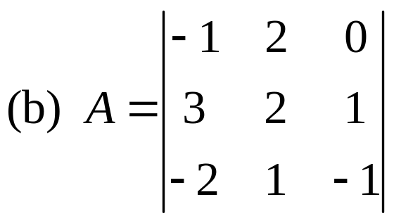
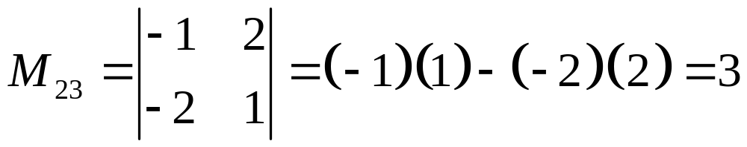
Copyright © 2012 Pearson Education, Inc. Publishing as Prentice Hall.

Slide 13
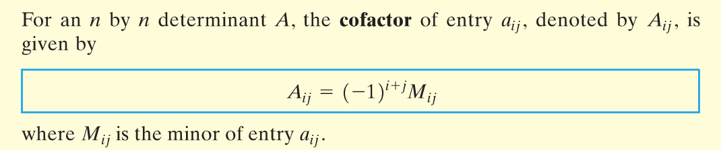
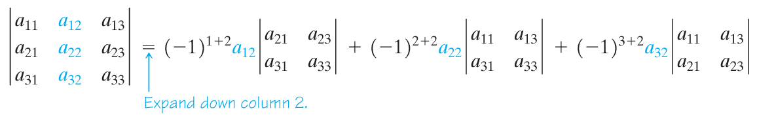
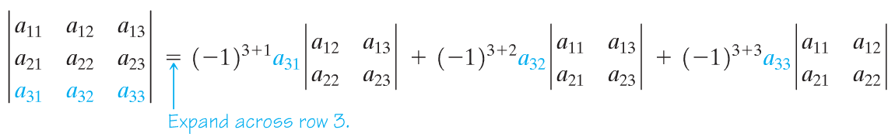
Copyright © 2012 Pearson Education, Inc. Publishing as Prentice Hall.

Slide 14
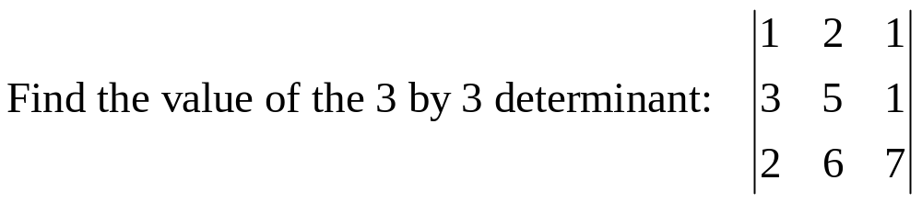
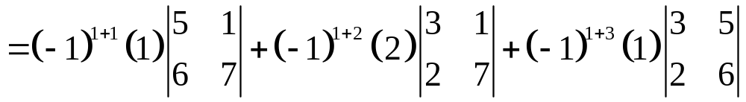

Copyright © 2012 Pearson Education, Inc. Publishing as Prentice Hall.

Slide 15
Copyright © 2012 Pearson Education, Inc. Publishing as Prentice Hall.

Slide 16
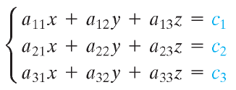
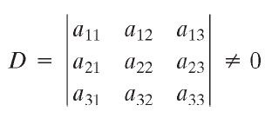
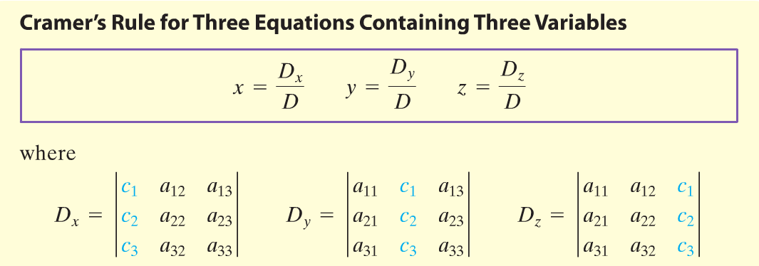
Copyright © 2012 Pearson Education, Inc. Publishing as Prentice Hall.

Slide 17

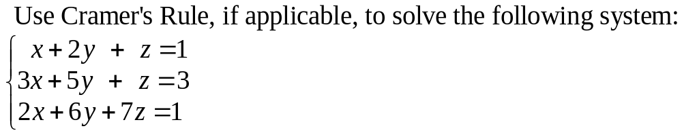
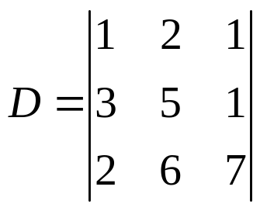
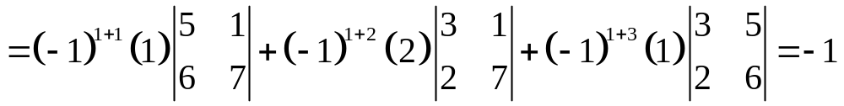
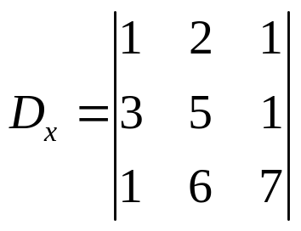
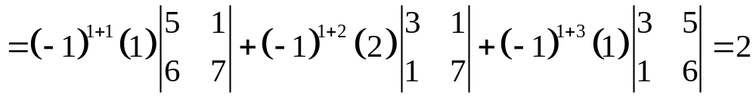

Copyright © 2012 Pearson Education, Inc. Publishing as Prentice Hall.

Slide 18

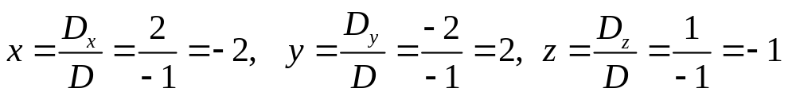
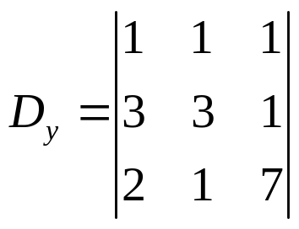
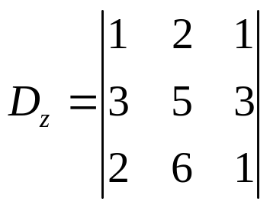
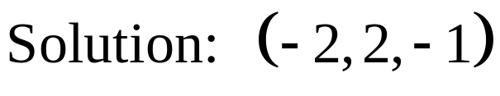

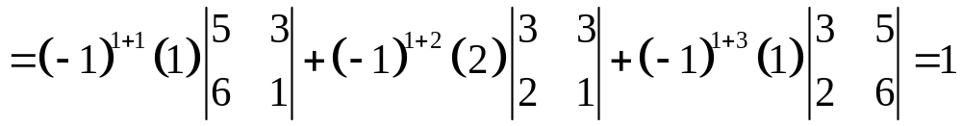
Copyright © 2012 Pearson Education, Inc. Publishing as Prentice Hall.

Slide 19
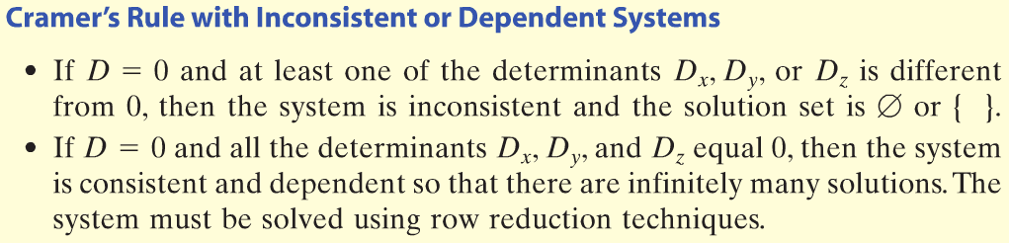
Copyright © 2012 Pearson Education, Inc. Publishing as Prentice Hall.

Slide 20
Copyright © 2012 Pearson Education, Inc. Publishing as Prentice Hall.

Slide 21
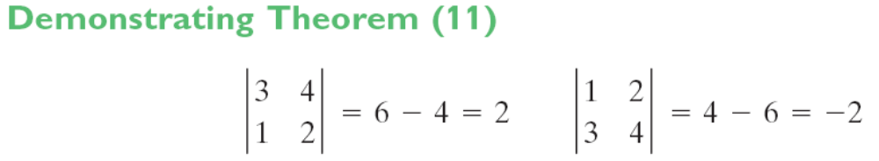
Properties of Determinants
Copyright © 2012 Pearson Education, Inc. Publishing as Prentice Hall.

Slide 22
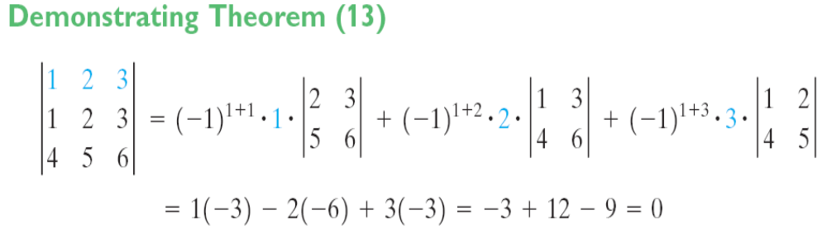
Properties of Determinants
Copyright © 2012 Pearson Education, Inc. Publishing as Prentice Hall.

Slide 23
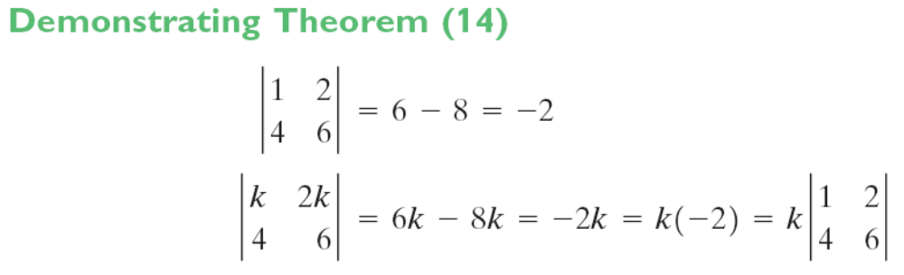
Properties of Determinants
Copyright © 2012 Pearson Education, Inc. Publishing as Prentice Hall.

Slide 24
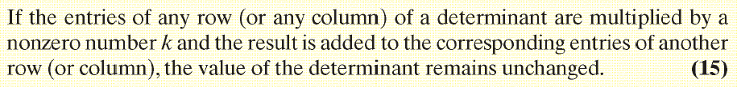
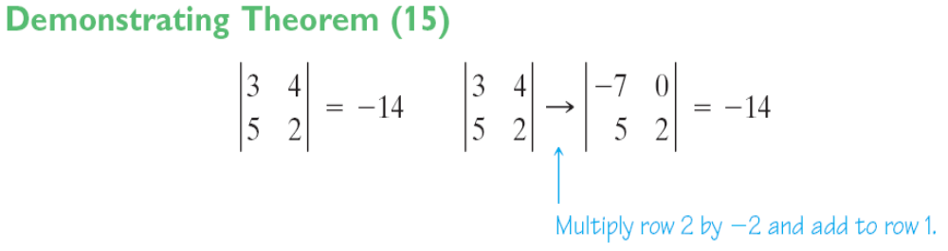
Properties of Determinants
Copyright © 2012 Pearson Education, Inc. Publishing as Prentice Hall.

